Slide 1


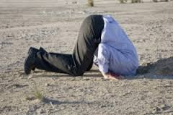
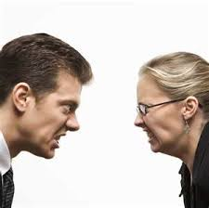
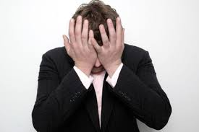
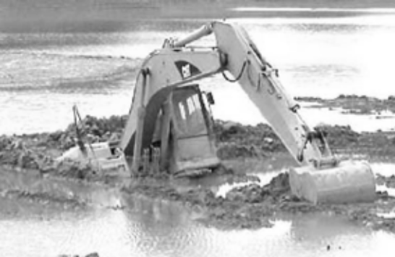
Difficult Debriefing

Slide 2

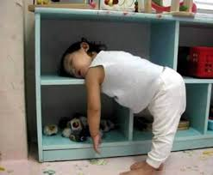

Sleeping can be harmful
Back
Dignity?

Slide 3
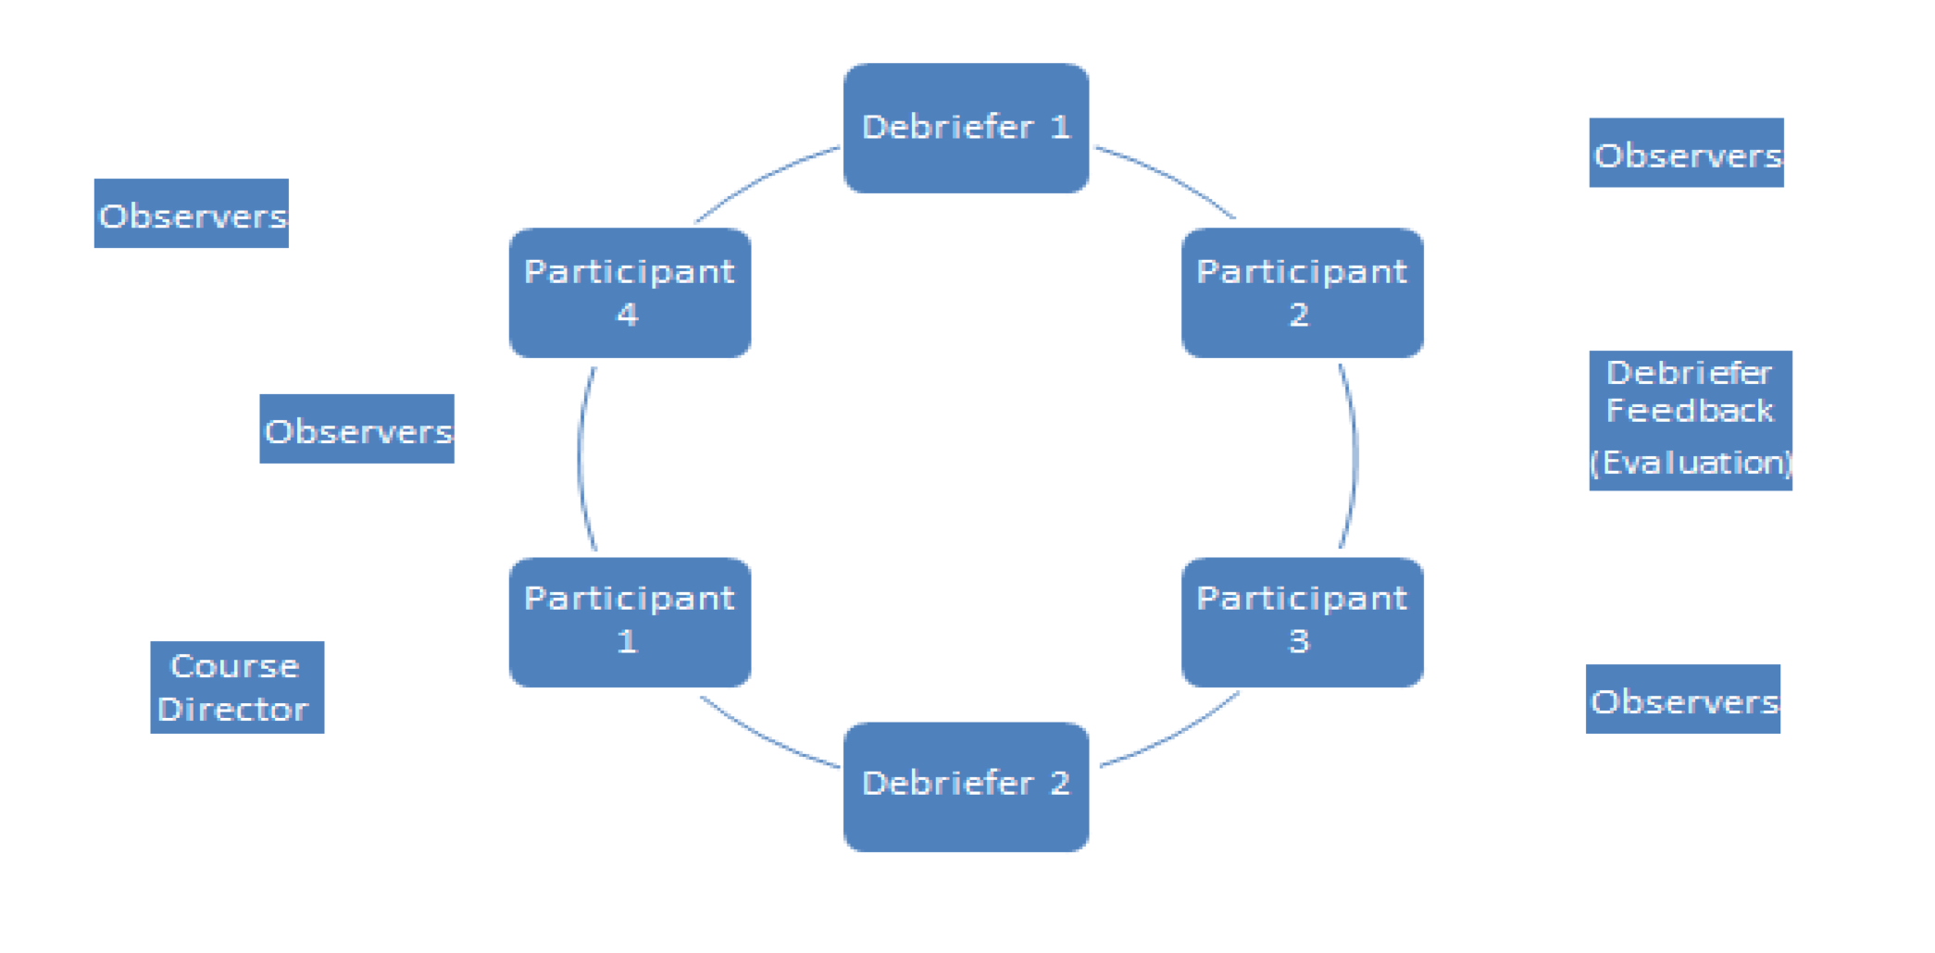
Set out the room
Use the correct body language
Work the room with Body positioning

Slide 4
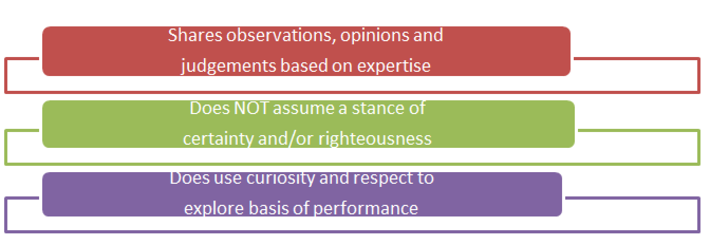
Prepare yourself for ‘Good Judgement’
Curious in the face of poor performance
Their solutions and thinking ‘frames’ before your own

Slide 5
The Pre-course Brief
  Explain the process (Adult Learners)
    15min Scenario, 40 minute discussion
    Group discussion to find solutions not just instruction or Assessment
  ‘Fiction Contract’
    Play themselves
    Attempt to maximise realism but won’t be fully so
    Most of information from the manikin, monitor
    If issue check with plant (role playing faculty)
    The please return to suspend disbelief
    Time and realism rules. Drugs and calls take time

Slide 6

The Pre-course Brief
  The Trust contract
    Non an assessment
      Tension pass/fail versus unfrozen self reflection that can change behaviour and performance
    Not an ordeal but an opportunity to learn
    Ok to make mistakes
    To do the job that we do– we are all intelligent and dedicated and are here to continue our career long development

Slide 7
The Pre-course Brief
  The Trust contract
    Discussing one’s performance can be uncomfortable but can bring great benefits to the whole group
    Acknowledge anxiety and evidence that it’s helpful
    ?Video consent form

Slide 8
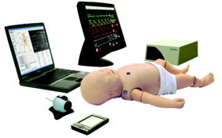
The Pre-course Brief
  Meet the manikin and Sim room
    List the basic features and how and where to find them
    List the known issues
      Wakefulness
      Chest sounds at the front
      Liver size/cap refill
    Equipment and Phone location
    Rely on the role playing faculty plant if can’t find something(may be not if in-situ)

Slide 9

Debriefing Environment
Ending the scenario--?neutral ?positive
Location
  Staring at the manikin
  Sitting vs standing
Size of room
Seating arrangement
Facilitator vs learners?
Name labels
Others walking through

Slide 10
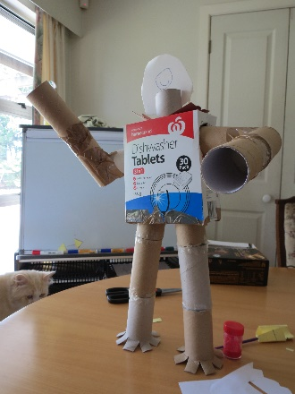
Simulation Artefact
(Fidelity issue)
‘Would have done better if…’
‘So hard to know whether this was happening..or who I could call’
  Refer to the Pre-brief
  Acknowledge these feelings
  Never be defensive or dismiss
  Affirm if a known manikin issue (others have said that
  Avoid fixation on this issue
    Generalise—’ever had these challenges in real life’
    Solutions to mitigate when there is uncertainty

Slide 11

The Extrovert
Either Insight positive or negative
  A ‘willing and able’ or a ‘willing and unable’ witness
May be due to great discomfort over their performance
  Listen and understand their point
  Spotlight others to comment
  Secondary generalise to other similar real life experiences

Slide 12
The Extrovert
May flit from topic to topic
Divert very off piste
  If valuable run with it
  If not in your Gathered list
    Backtrack—could I pick up on…..
    Post it- Come back to it (at the end or in a break)
Focus elsewhere in the room

Slide 13

Silent Participant
Non engaged learner
  If the whole group consider a +/Δ
  Went well/would you change
Upset and emotional
  Acknowledge and open the strategy toolbox
Argumentative
Hierarchy Gradient

Slide 14
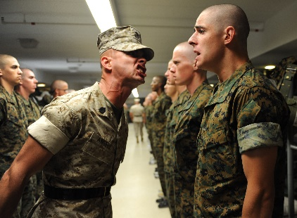
Hierarchy Gradient
Huge area of focus for airline captains
Sometimes very tough to speak up at the bottom
  Spotlight good practice.
  Focus on roles/sub teams or first response
  ?anonymous feedback technology

Slide 15
Hierarchy Gradient
Sometimes very tough to fail at the top
  Leave your preconceptions at the door
  Open Observations to encourage self reflection
  Sensitive and dip into the strategy toolbox
  Discuss challenges
  Inclusive Leadership
  Supportive Followship

Slide 16
Extreme Reaction
Upset/Frozen/Withdrawn
  Acknowledge
  Normalise as a common experience
  Deflection
    Anyone else felt these challenges/similar experience
    Does a leader need to think of it all (followship)
    Offer own experience
  Offer to talk later (afterwards, later on)
Don’t forget your other learning objectives

Slide 17
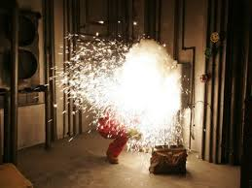
Equipment Failure
Stop and Start the scenario
  Each team member adds to a situation report and picks the next intervention
  ?avoid beside debrief—can confuse
Throw in a faculty member to be the clinical signs caller and monitor
Run again for team working
  Rapid cycle deliberate practice
Sim Mon app ipad & iphone

Slide 18

Advanced Debriefing Strategy Toolbox

Slide 19

Validation Strategy
• Use when:
– Learners are fixated, you want to move on
– Learners are overly critical of themselves
• How to do it:
– Listen actively
– Agree with the learner
– Be genuine
– Validate their concerns
-- Pause

Slide 20

Generalisation Strategy
• Use when:
– Learners can’t see the relevance of
discussion
• How to do it:
– Expand discuss to other contexts
– Draw parallels
– Discuss similarities
– Highlight relevance

Slide 21

Broadening Strategy
• Use when:
– Learner(s) are fixated
– One learner dominating discussion
– Quiet learner
• How to do it:
– Broaden discussion to the group
Explore perspectives
– Body language

Slide 22

Previewing Strategy
• Use when:
– Tangential discussion
– Distractible learners
– You want to gain control
– You want to highlight an important point
• How to do it:
– Introduce topic of discussion
– Be explicit

Slide 23

Normalization Strategy
• Use when:
– Learner(s) feel bad about themselves
• How to do it:
– Empathy
– Tell them a story about a similar
experience
– Pause

Slide 24

Refocusing to
Objectives Strategy
• Used when:
– Discussion gets off topic
– Tangential / distractable learners
• How to do it:
– De-briefer tries to refocus discussion back to relevant issues
– Best used when learners are “ready

Slide 25
Take Home Messages
• Difficult debriefing isn’t always 100%
due to the learner
• Optimize your environment
• Use specific strategies
• Stack your strategies

